Slide 1
Team Structures and Operations on AWS
Advisory Services

Slide 2

Common Stages of Cloud Adoption
Customer: Enterprises in this stage have migrated a meaningful portion of their existing IT portfolio to the cloud. These customers are now focused on optimizing their business and technology processes in light of the new capabilities they’ve developed in their organizations. This removes any limitations on the types of workloads the enterprise is willing to run on AWS (brown-field & legacy systems). We expect most enterprises to declare themselves as “cloud-first” for net-new workloads during the Project or Foundation stages of their journey.
Optimization
Migration
Customer: Enterprises in this stage migrate existing applications, including mission-critical applications, or entire data centers to the cloud as they look to scale their adoption across a growing portion of their IT portfolio. They make investments necessary to sustain long-term IT operations in the cloud.
Customer Value
Foundation
Customer: Enterprises in this stage have begun to see the benefits of cloud, and are making foundational investments so that they can begin scaling their adoption. This includes the creation of a cloud center of excellence and supporting artifacts (development of hybrid architectures, reference architectures, Identity Management processes, standardized cost management processes and cloud operations management processes), and other investments like VPC, Direct Connect and AWS skills training that will allow them to scale their adoption across a growing portion of their portfolio. AWS is viewed as complementary to existing systems and becomes an option for additional projects.
Project
Customer: Enterprises in this stage are dipping their toe in the water to determine how they may benefit from what cloud has to offer. AWS is evaluated and vetted on a project-by-project basis to solve specific needs on a one-off basis (e.g., deploying Proof of Concept workloads).
Cloud Adoption Over Time
Notes:
SLIDE MESSGE: Through our experience of advising and guiding complex enterprises through their transformations, we’ve identified a common set of ”stages” each progressed through . We’ve outlined the Enterprise Personalities and associated stance on cloud adoption on each.

Slide 3
AWS Cloud Adoption Framework = Balanced Maturity
People Perspective
What will your cloud migration and steady state teams look like?
What skills and capabilities are required?
Business Perspective
How do we define our Corporate cloud objectives?
How do you measure costs and value as Business strategies change?
Business
Perspective
Platform
Perspective
Process Perspective
How will you track, manage, define new products and services that are now cloud?
Does your code pipeline allow for visibility, feedback, and continuous deployment?
Platform Perspective
How do you manage your capacity needs, design architecture foundations, implement a Business Continuity plan including HA /DR?
Process
Perspective
People
Perspective
Maturity
Perspective
Operations
Perspective
Security
Perspective
Security Perspective
Have risk profiles been documented for key applications?
Operating Perspective
Have you looked at how automation frameworks and development pipelines affect Change Management?
Notes:
SLIDE MESSAGE: Transformation by way of cloud adoption will require maturity across a spectrum of areas, beyond Technology. Our CAF provides a balanced approach to transformation and the ”levers” of maturity that will need to be pulled to be successful

Slide 4
AWS Cloud Stages of Adoption

Slide 5
AWS On-Boarding Service Program
Cloud Adoption Simulation Workshop
Security Strategy Workshop
AWS Platform
Jumpstart
Portfolio Prioritization
Skills Assessment & Tiger Team
Notes:
SLIDE MESSAGE: through our work with large enterprises, we’ve been able to develop prescriptive first steps to adopting cloud. These are the fundamental actions and groundwork that need to be laid to set an organization’s path to successful cloud adoption and transformation. This package of services is designed to move a customer from the PROJECT stage to the FOUNDATION stage of adoption.

Slide 6
AWS Foundation Service Program
Cloud Team (COE) Design
Security Playbook & Runbook
Pilot Migrations & Artifacts
Training & Certification Plan
Cloud Operations Playbook & Runbook
Notes:
This package of services is designed to move a customer from the FOUNDATION stage to the MIGRATION stage of adoption.

Slide 7
AWS Cloud Stages of Adoption

Slide 8
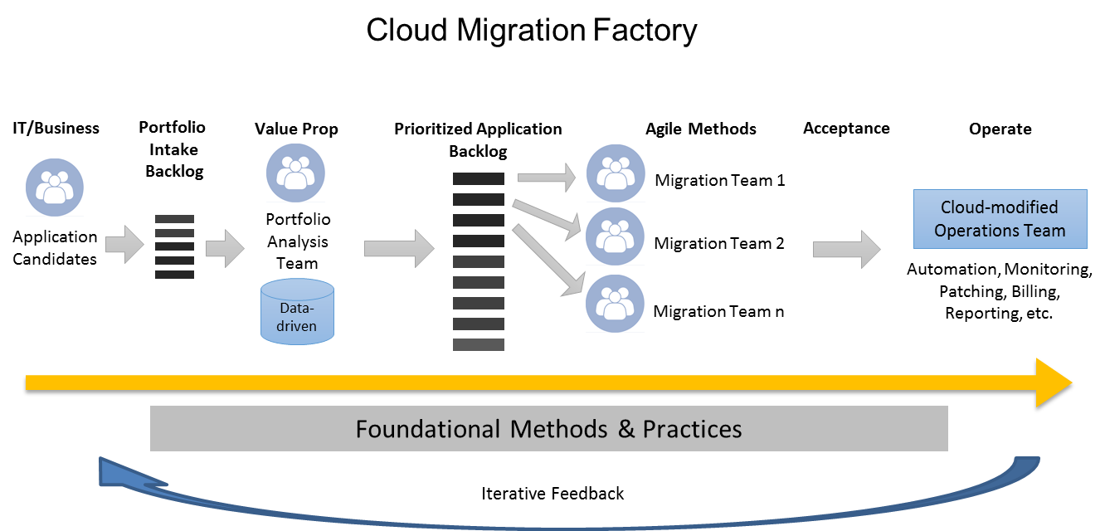
Notes:
Once you have reached a Foundational level of maturity, you are able to execute the migration strategy that fits your business best. This is an example of our recommended migration factory for customers desiring to move applications to cloud at scale and velocity.

Slide 9
AWS Cost Reduction Checklist: Post-Rehost
Stage 1: Rehost (Lift & Shift) (-10-30%)
Stage 2: Right Sizing Infrastructure based on Utilization (-30-50%)
Stage 3: Right Sizing Licensing based on Utilization (-30-50%)
Stage 4: Architecture Optimization (-10-30%)
Stage 5: Operations Automation (-10-20%)
Stage 6: Reserved Instances (-20-60%)
Stage 7: Process Improvements (DevOps, CI/CD) (-20-30%)
Stage 8: Enterprise Discount Program (EDP) (-X%)
Stage n: AWS Innovations and On-going Reductions (-X%)

Slide 10
Notes:
Your cloud operations team has to be ready to run these apps.

Slide 11
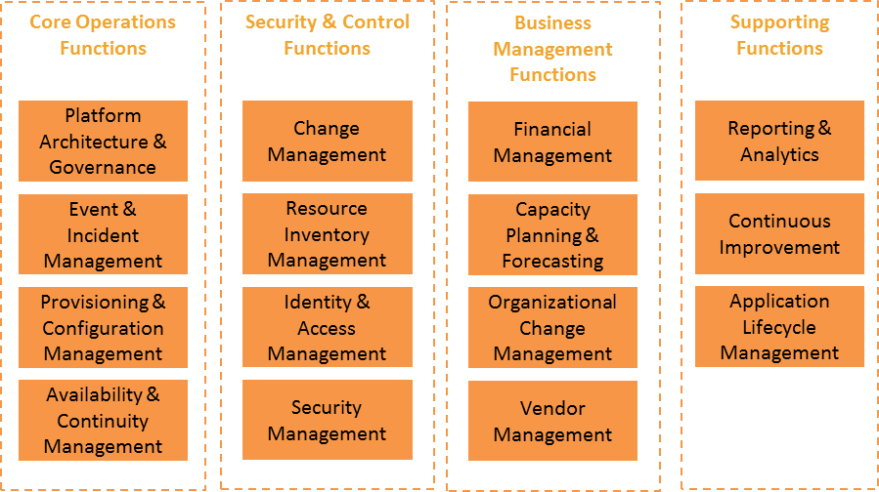
Cloud Operational Functions Based on Analyst reports and AWS Case Studies
Notes:
Here are the 15 functions that every cloud operations team needs to cover …we’ve aligned this to ITIL and tooling responsibility between Dev and Ops.

Slide 12


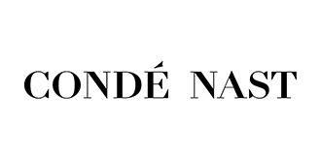
Estimated Labor Efficiencies Based on Analyst reports and AWS Case Studies
Efficiencies | AWS Experience | Analyst Reports
Build | 44% | 57%
Run | 46% | 64%
Organization | Cost Reduction
Conde Nast | 40%
GE Oil & Gas | 52%
AdRoll | 83%
Dow Jones | 25%
Comba Telecom | 40%
Euclid | 80%
University of Notre Dame | 40%
IDC Study 2015 | 64.3%
With 75% of its operations in AWS, saving $20M annually
35% reduction in compute assets
52% average TCO savings
77% faster delivery of business applications
311 applications migrated in 18 months
40% cost reduction
30-40% increase in operational performance

Slide 13
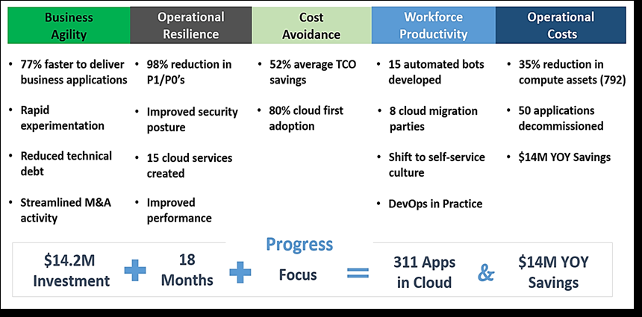
GE’s Cloud Migration Results (Efficiencies & Innovation)

Slide 14
Cost-savings and Innovation ROI
Innovation investment returns increase over time
Continually increased returns
Cost-saving returns diminish as operational automation matures
Notes:
The combination of both approaches (cost-savings and innovation) are key to driving top line revenue up and IT cost down… increasing total operating margin and making your company stronger and not just cheaper.

Slide 15
Infrastructure as Code is a practice in which infrastructure is provisioned and managed using code and software development techniques, such as version control and continuous integration and delivery.
Notes:
New World… Using code to automate these process and have the different layers interact with each other.
Because every layer is talking in code, you can automate more instead of relying on an individual software package to complete/manage one operational task

Slide 16
Full stack layers
Application Configuration
Operating System and Host Configuration
Infrastructure
Notes:
Can be simplified into 3 layers

Slide 17
Current functional areas covered
Configuration Management Integration
Testing
Release Management
Infra, App & Network Monitoring
Access Control, Security
Logging
Source Code Management
Artifact Repository
Infrastructure Provisioning
Performance Testing
Incident Management
Application Configuration
Operating System and Host Configuration
Infrastructure
Notes:
Are we missing anything? What tools are you using to accomplish this? How are the different layers interacting with each other? Manual effort

Slide 18
Infrastructure as Code “tiers”
Application Configuration
Operating System and Host Configuration
AWS Infrastructure
AWS CloudFormation
Hashicorp Terraform
Notes:
Now we do these things as infrastructure of code… New school tools

Slide 19
Infrastructure as Code “tiers”
Application Configuration
Ansible
Chef
AMIs
Operating System and Host Configuration
Puppet
Salt
Packer
AWS Resources
Powershell
Notes:
New school

Slide 20
Infrastructure as Code “tiers”
CodeDeploy
Application Configuration
Containers
Powershell/MSI
serverless
Operating System and Host Configuration
Swagger
AWS Resources

Slide 21
The “red line”
Dev
Application Configuration
Ops
Operating System and Host Configuration
AWS Resources
What Operations usually wants.

Slide 22
The “red line”
Application Configuration
Operating System and Host Configuration
Dev
AWS Resources
Ops
What Development usually wants.

Slide 23
Your “red line”
?
Application Configuration
Operating System and Host Configuration
AWS Resources
Security, application sensitivity, organization history, staff skills + experience, adopted technologies, business goals, leadership, and many other factors play in here for where the red line will be in your business.

Slide 24
Successful Cloud Team Structures

Slide 25
IT
Shared Services
Enterprise Architecture
Security
The central IT organization wants to adopt cloud to lower costs, keep information secure, and support the Business Units with relevant services
Notes:
Let’s keep this simple and walk through a transformation step by step…
(this slide is about what the central IT org wants to move to the cloud )

Slide 26
IT
Run Efficient
Shared Services
Enterprise Architecture
Security
Dev Team #1
Profile of App(s)
Innovate Fast
The central IT organization wants to adopt cloud to lower costs, keep information secure, and support the Business Units with relevant services
Dev Teams want to adopt cloud to increase their speed-to-launch and deliver innovative to their users

Slide 27
IT
Run Efficient
Shared Services
Enterprise Architecture
Security
Cloud
Dev Team #1
Profile of App(s)
Innovate Fast
Cloud Tiger Team (CTT)
Team Leader
Cloud Architect Lead
Cloud Security Lead
Operations Engineer Lead
Financial Analyst
Notes:
IT Steps:
Gather leading cloud talent; including architecture, security, and operations into one team
If cloud talent gaps exist or additional training is needed, consider using a vendor-partner to fill gaps and empower team; however, note that long-term knowledge ownership by your organization is key
CTT becomes source of truth for recommended cloud architecture, operations automation, and governance
BU Steps:
BU ready, willing, and able to adopt Cloud with assistance of the CTT
BU’s Dev Team’s should have apps that can benefit from advantages of cloud and be able to identify their primary goal

Slide 28
IT
Run Efficient
Shared Services
Enterprise Architecture
Security
Cloud
Dev Team #1
Profile of App(s)
Innovate Fast
Cloud Tiger Team (CTT)
Team Leader
Cloud Architect Lead
Cloud Security Lead
Operations Engineer Lead
Financial Analyst
What is an Operations Engineer?
An OE engages on the Dev Team during migration to help them design highly automated and resilient cloud applications by providing expertise on the cloud infrastructure (as code) components. An OE helps the Dev Team identify and create “Good Production Hygiene” and effectively build a bridge toward DevOps by extending Operations out into the Dev Team.
How many OE’s do I need?
Dev Team Size | Number of people on Dev Team | OE:DevTeam ratio | Description
Small | 1-6 | 3:1 | OpsEng can handle 3 small teams simultaneously
Medium | 7-9 | 2:1 | OpsEng can handle 2 medium simultaneously
Large | 10-12 | 1:1 | OpsEng can only handle 1 large team
XLarge | 13+ | 0.5:1 | Two OpsEng’s needed to handle one Xlarge team
Notes:
Cloud Architects come from EA org – receive AWS training
Cloud Security Leads come from Security team – receive AWS ProServe Security Workshop
OE – needs scripting and cloud knowledge. A little harder to find, but we can provide a sample job description and temporary job fulfillment (AWS ProServe)

Slide 29
IT
Run Efficient
Shared Services
Enterprise Architecture
Security
Cloud
Dev Team #1
Profile of App(s)
Innovate Fast
Cloud Tiger Team (CTT)
Team Leader
Cloud Architect Lead
Cloud Security Lead
Operations Engineer Lead
Financial Analyst
Notes:
IT Steps:
CTT engages and embeds temporarily in Dev Team to provide hands-on cloud expertise
CTT remains embedded in Dev Team until desired level of maturity (aka “good production hygiene”) is reached as measured by DevOps scorecard
BU Steps:
CTT helps BU (possible just a few Dev Teams) becomes self-sufficient with Cloud architecture, security, provisioning, and operations
Can use “Good Production Hygiene” scorecard” to gauge maturity
Once satisfied, the BU no longer needs hands-on help, the CTT is released to go help another BU

Slide 30

IT
Run Efficient
Shared Services
Enterprise Architecture
Security
Cloud
Dev Team #1
Profile of App(s)
Innovate Fast
Cloud Tiger Team (CTT)
Team Leader
Cloud Architect Lead
Cloud Security Lead
Operations Engineer Lead
Financial Analyst
Portfolio Tier | Application Characteristics | Delivery model
Differentiate | High rate of change. Usually customer facing, business-critical, and revenue generating | DevOps
Table Stakes | Business critical, but low rate of change. Needs high availability, maximum reliability, and durable DR. | Automated Efficiency
Niche | Non-Business-critical, low change, minimal risk, standard downtime & reliability requirements | Traditional Operations
Notes:
IT Steps:
CTT engages and embeds temporarily in Dev Team to provide hands-on cloud expertise
CTT remains embedded in Dev Team until desired level of maturity (aka “good production hygiene”) is reached as measured by DevOps scorecard
Dev Team Steps:
CTT helps Dev Team becomes self-sufficient
Use “DevOps scorecard” to gauge maturity
Once satisfied, Dev Team no longer needs hands-on help, the CTT is released to go help another Dev Team

Slide 31

IT
Run Efficient
Shared Services
Enterprise Architecture
Security
Cloud
Dev Team #1
Profile of App(s)
Innovate Fast
Once cloud-enabled the CTT is released
Cloud-enabled
Cloud Tiger Team (CTT)
Team Leader
Cloud Architect Lead
Cloud Security Lead
Operations Engineer Lead
Financial Analyst
Run Efficient
Dev Team #2
Profile of App(s)
Then, engages with next Dev Team
Innovate Fast
Notes:
IT Steps:
Once released by Dev Team #1, CTT engages with next ready, willing, and able Dev Team.
Dev Team Steps:
Dev Teams are cloud-enabled by CTT, continually assess themselves against the scorecard until desired level of maturity is reached (not always L5-Advanced)

Slide 32
IT
Run Efficient
Run Efficient
Shared Services
Enterprise Architecture
Security
Cloud
Dev Team #1
Profile of App(s)
Innovate Fast
Innovate Fast
Cloud Tiger Team (CTT)
Team Leader
Cloud Architect Lead
Cloud Security Lead
Operations Engineer Lead
Financial Analyst
Run Efficient
Run Efficient
Dev Team #2
Profile of App(s)
Innovate Fast
Innovate Fast
Cloud Center of Excellence (COE)
Run Efficient
Run Efficient
Dev Team #3
Profile of App(s)
Big Data
IOT
Mobile
Specialties Aligned with Innovation
Innovate Fast
Innovate Fast
Notes:
Where do you staff the COE from? Staff from Shared Services, EA and even from the BU’s align with their specialty in the COE as cloud adoption grows. For some roles, additional training will be needed, for others, there will be a direct path.

Slide 33
IT
Run Efficient
Run Efficient
Shared Services
Enterprise Architecture
Security
Cloud
Dev Team #1
Profile of App(s)
Innovate Fast
Innovate Fast
Cloud Tiger Team (CTT)
Team Leader
Cloud Architect Lead
Cloud Security Lead
Operations Engineer Lead
Financial Analyst
Run Efficient
Run Efficient
Dev Team #2
Profile of App(s)
Innovate Fast
Innovate Fast
Cloud Center of Excellence (COE)
Run Efficient
Run Efficient
Dev Team #3
Profile of App(s)
Big Data
IOT
Mobile
Specialties Aligned with Innovation
Innovate Fast
Innovate Fast
Migration #1
Migration #2
Migration #n
Cost-savings Specialists
Notes:
Where do you staff the COE from? Staff from Shared Services, EA and even from the BU’s align with their specialty in the COE as cloud adoption grows. For some roles, additional training will be needed, for others, there will be a direct path.

Slide 34
IT
Run Efficient
Run Efficient
Shared Services
Enterprise Architecture
Security
Cloud
Dev Team #1
Profile of App(s)
Innovate Fast
Innovate Fast
Cloud Tiger Team (CTT)
Team Leader
Cloud Architect Lead
Cloud Security Lead
Operations Engineer Lead
Financial Analyst
Run Efficient
Run Efficient
Dev Team #2
Profile of App(s)
Innovate Fast
Innovate Fast
Cloud Center of Excellence (COE)
Run Efficient
Run Efficient
Dev Team #3
Profile of App(s)
Big Data
IOT
Mobile
Specialties Aligned with Innovation
Innovate Fast
Innovate Fast
Migration #1
Migration #2
Migration #n
Cost-savings Specialists
Financial Mgmt
Vendor Mgmt
Reporting & Analytics
Admin Tasks
Notes:
Where do you staff the COE from? Staff from Shared Services, EA and even from the BU’s align with their specialty in the COE as cloud adoption grows. For some roles, additional training will be needed, for others, there will be a direct path.

Slide 35
IT
Run Efficient
Run Efficient
Shared Services
Enterprise Architecture
Security
Cloud
Dev Team #1
Profile of App(s)
Innovate Fast
Innovate Fast
Cloud Tiger Team (CTT)
Team Leader
Cloud Architect Lead
Cloud Security Lead
Operations Engineer Lead
Financial Analyst
Career growth
Run Efficient
Run Efficient
Dev Team #2
Profile of App(s)
Innovate Fast
Innovate Fast
Cloud Center of Excellence (COE)
Run Efficient
Run Efficient
Dev Team #3
Profile of App(s)
Big Data
IOT
Mobile
Specialties Aligned with Innovation
Innovate Fast
Innovate Fast
Migration #1
Migration #2
Migration #n
Cost-savings Specialists
Financial Mgmt
Vendor Mgmt
Reporting & Analytics
Admin Tasks
Notes:
Blue lines are ideas, not people. Where do you staff the COE from? Staff from Shared Services, EA and even from the BU’s align with their specialty in the COE as cloud adoption grows. For some roles, additional training will be needed, for others, there will be a direct path.

Slide 36
Master operational list of everything that needs to be covered
Notes:
More details on this subject provided in the backup slides. There is a slide where we’ve aligned this to ITIL and tooling responsibility between Dev and Ops.

Slide 37
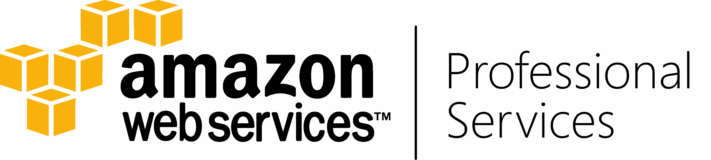
Develop playbooks on each of the 15 operational functions
Define traditional and target model approach
Define AWS-specific roadmap
Activity | Traditional Approach | Target Model
Event Monitoring | SNMP traps via proprietary network management systems (e.g. HP OpenView) that are difficult to customize and automate. If managed by MSP, details are not shared with customers unless they use the same network management system or pay for integration. Customers notified by outbound case/email. Engineers must investigate all events to determine if there is an incident. | Monitoring performed by monitoring tool of choice using metrics, thresholds, and multi-metric event detection. Integration of events and incidents to other enterprise IT tools is easy with published APIs and pre-built plugins. Proactive scripts launch workflows that can handle known events automatically; meaning, incidents become an anomaly and are actually worthy of an engineer’s time to investigate. If customers do need to be notified, they are done so by the contact method of their choice (email, HTTP, SMS).
 | Shortcomings: Human intervention necessary to determine if events are really incidents; increases cost and slows response and escalation | Advantages: Increased productivity and resolution rates of incidents by engineers due to self-healing automation. Implementation of a continuous monitoring method improves your security posture and enables anytime measurement of your resources against internal and/or regulatory compliance. Increased ability to perform meaningful forensics on incidents due to improved visibility into point-in-time configuration changes and a complete data stream of API-call logging.
Target Model implemented on AWS
With AWS, monitoring tools are available to monitor and alert regarding AWS services. These tools can be accessed directly through the AWS Console or via API, which can be routed to Shell’s enterprise monitoring tool of choice AWS’s many services and deployment flexibility options result in applications being classified more granularly according to its true uptime and retention needs. Launching this applications on AWS using innovative architecture recommendations like Pilot-light and Warm-standby, results in every application being able to afford at least some level of easy recoverability. In addition, Business Critical applications that require multi-site redundant infrastructures for maximum uptime can take advantage of the global dispersion of AWS regions, network, and edge locations, currently operating on all six major continents.
Notes:
Building Capabilities and Capacity
Design, Build, and Operate
Joint Customers and/or Internal Readiness
Value to Partners with Customers
Look Bigger, Be Better, Go Faster
Pro Services goals and priorities
Enterprise adoption, references, reusables, & partners

Slide 38
Application Value-Stream
orient
assess
recommend
onboard
BUild
SUSTAINMENT
Plan
TEST
HAND
Back
Swim-lane
Support
Application
Automation
Checklist
SUPPORT
deploy
RETRO
support
Notes:
Left half is app dev
Automation checklist defines “what good looks like”… across the run ops swim lane options (IaaS, Automated Efficiency, DevOps)
Once deterimined what swim lane app goes in... Then Run Ops model and cost is assigned (IaaS- $$$, Automated Efficency- $$, DevOps- $)
“You’re either going to pay for humans or you’re going to pay to build automation... Only one is near infinitely repeatable.”

Slide 39
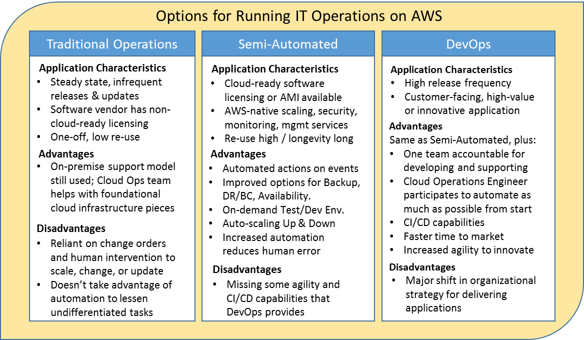
Run Operations Swim Lanes
IaaS

Slide 40
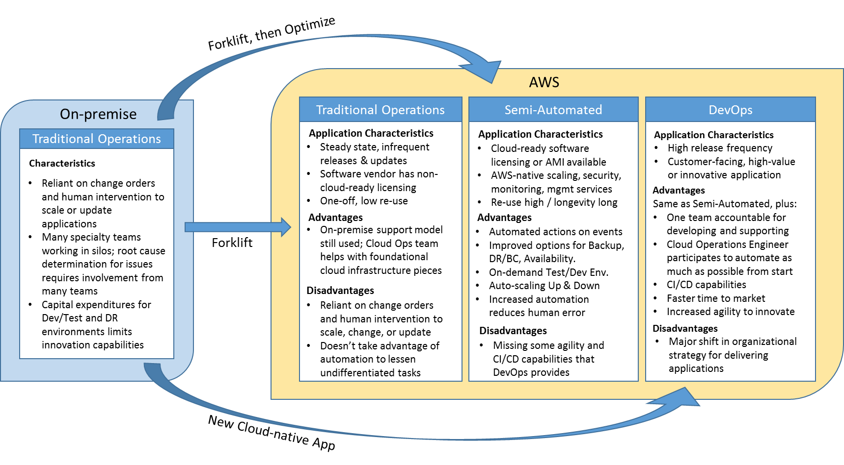
Migration Scenarios per Run Operations Swim Lanes
IaaS

Slide 41
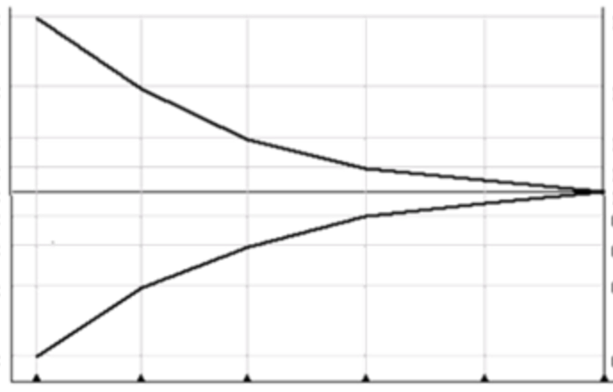
Efficiency Correlation to Swim Lane Type
Legacy architectures forklifted onto AWS requires similar roles/workforce as on-premise. Lack of automation means Cloud Eng’s can manage a “few” apps each.
“Forklift, then Refactor” to semi-automated enables full-stack Cloud Eng 2&3 to manage “tens” of apps at once thanks to cloud-native tools & automation.
Optimal for new app dev; “build it / run it” strategy breeds accountability. Cloud Eng L3 can operate “many tens” of cloud applications.
IaaS
Number of
Roles, Teams,
& Responsibilities
Semi-automated
DevOps
Full automation
Codified processes/
Automation efficiencies
Roles required
to operate
Cloud Engineer L2
Cloud Engineer L1
Current Shared Services
Cloud Engineer L3
Cloud Engineer L2
Cloud Engineer L3

Slide 42
Multi-Modal Support Operations
Incident
Tier 1
Call Center
Support Mode?
Tier 2
(Infra, Network)
“Traditional On-premise”
”Cloud”
Tier 3
(App)
Swim Lane
Support
IaaS
Tier 4
(Dev Team, Systems, security, db admins)
Automated Efficiency
CI/CD DevOps
Responding Specialist / Escalation

Slide 43
Delivery Model and Responsible Party
Design
Ops
Design
Ops
Design
Ops
Apps
COTS
Vendor
HCL
Apps
Business &
Accenture
Wipro &
Accenture
Apps
xxxx
yyyy
COTS
DevOps CI/CD
Etc.
Infra
Capgemini
Corporate
Ops
Infra
Capgemini
Corporate
Ops
Infra
zzzz
nnnn
SAMPLE PARTNERS
Notes:
High level RACI defines responsible party and who will participate across time. SAMPLE

Slide 44
Operating Model
Design
Operations
Applications
CI/CD
Management
Dev,Test, Prod
Infrastructure
Applications
COTS
Code
Etc.
Support
Code &
Config
Source Code Repository / Service Catalog
J
J
IaaS
Templates
Landscapes
Infrastructure
Semi-Automated
AMI
DevOps
API
Cloud COE / Ops
Notes:
Applications want to run on AWS. the app team (Code and config) take code and config and apply to aws infra managed by sentinel
Code application Lifecycle Dev test and prod.
When launching infra, you launch a stack, not just an instance (Templates for stacks include things like security groups, vpc, account,
Attached code to template (landscapes)
CCOE – team that does the infra design and determines how the whole system should work.
Scaling ent ops assumes two things
Customer wants to change operate model
customer using basic AWS services - not designed to support lambda/ multi-platform

Slide 45
“Infrastructure as Code” Treat IT infrastructure as code and enable your Developers
Application
Write
App Code
Build/
Compile
Code
Unit Test
App Code
Deploy
Package
App / Infra
App
Dev Env
Dev
Test Env
Source Code Management
Artifacts
Infra
Stg Env
Build
Infra Code
Build
Images
Validate
Templates
Automate
Deployment
Prod Env
Ops
Infrastructure
Notes:
This is how those different team types fit together

Slide 46
Execution Model
First 90 days – Cycle 1
Next 90 days – Cycle 3
Next 90 days – Cycle 2
Next 90 days – Cycle 4
Architecture
Tools
AWS ProServe & Customer/Partner Shadow
Process
AWS ProServe & Customer/Partner Together
Customer/Partner Lead
People

Slide 47
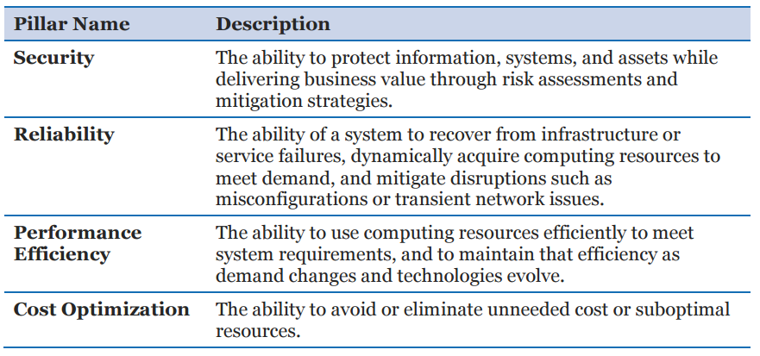
What does “good” look like?
Need a framework for all of your partner vendors to use as a rubric during Build/Test/Run
Example: AWS Well-Architected Framework

Slide 48
DevOps team patterns
T1: Temporary DevOps is team formed to bring Dev and Ops closer together. DevOps team is temporary and dismissed according to predefined success criteria. Dev teams own individual lifecycle. Successful result of this construct is T1, T3, T4, or T5.
DevOps
Dev
Ops
T2: DevOps is collaboration and even overlap between Dev and Ops working for and belonging to both. This is true built-it/run-it, with Dev and Ops teams working toward the same application goals.
DevOps
Dev
Ops
T3: Ops as Infrastructure-as-a-Service offers a traditional “shared infrastructure services” feel to Dev teams. Small DevOps team provides liaison support to Dev team for IaaS related features provided by Ops (e.g. monitoring, provisioning, etc.)
DevOps
Dev
Ops

Slide 49
DevOps team patterns
T4: This model is Build/Run via a Cloud Operations Engineer (aka Cloud Ninja). Ops services, processes and tools are sourced from an Ops point of view and delivered as a service to Dev teams as services. The concierge for delivery of these services is the Cloud Operations Engineers, which embed with Dev teams (hopefully temporarily). The goal for Operations Engineers should be to put themselves out of a job by enabling the Dev team to become Ops-savvy and self-sufficient.
Ops Engineer
Dev
Ops
T5: This organizational construct is a maturity of T4, instantiating a Site Reliability Engineer (SRE) in between the Dev and Ops teams. Cloud Ops Engineers still provide initial Ops expertise as in T4, but once applications have passed a checklist of testing, automation, and uptime metrics, the SRE’s takes over day-to-day operations and oversight (pager-duty). This construct is a “reward for the Dev teams” and marks a maturity point they are no longer first-responders to their applications after-hours (SRE’s job).
Ops Engineer
Dev
SRE
Ops

Slide 50
IT Infrastructure as Code Treat IT infrastructure as business application
Application
Write
App Code
Build/
Compile
Code
Unit Test
App Code
Deploy
Package
App / Infra
App
Dev Env
Dev
Test Env
Source Code Management
Artifacts
Infra
Stg Env
Write
Infra Code
Build
AMIs
Validate
Templates
Automate
Deployment
Prod Env
Ops
Infrastructure
Notes:
This is how those different team types fit together

Slide 51


Ops-Driven organizational methods: Cloud Operations Engineer
Cloud Operations
Engineer
Development Team
Operations Team
Done? | Automation Checklist
✔ | App and Infra src managed
✔ | App config externalized
✔ | Infra config externalized
✔ | Auto build app
✔ | Auto build infra (IAC)
✔ | Auto deploy
✔ | Auto test - unit
 | Auto test - component
 | Auto test - smoke
 | Auto test - regression
 | Auto test - Perf
 | Auto test - Failover
 | Auto test - Duration
Good production hygiene
DevOps Team

Slide 52
Cloud Operations Engineer Assignment and Sizing
Cloud Operations
Engineer
Development Team
Operations Team
Dev Team | Size (number of people on team) | OpsEng/ Team ratio | Description
Small | 1-6 | 3:1 | OpsEng can handle 3 small teams simultaneously
Medium | 7-9 | 2:1 | OpsEng can handle 2 medium teams simultaneously
Large | 10-12 | 1:1 | OpsEng can only handle 1 large team
XLarge | 13+ | 0.5:1 | Two OpsEng’s needed to handle Xlarge team
DevOps Team

Slide 53
Sounds great, where do I get some of that?
Cloud Operations
Engineer (OE)
Site Reliability
Engineer (SRE)
Questions | Answers
Where do these roles come from? | Existing staff with Cloud and Operations savvy; drive for career growth You create them with a two-in-a-box approach (e.g. AWS ProServe lead)
Where do they sit? | OE - Cloud Tiger Team SRE – Dev Teams, but should be dotted-lined back to Cloud Tiger Team OE’s
How do you make more? | Rotate OE’s back into existing IT org (e.g. shared services) to recruit, train, and multiply. Brown bag trainings

Slide 54
Backup slides

Slide 55
Why are we here? It’s all about speed… Bridge the gap between Dev and Ops to increase agility
Dev
Operations
Product Owner/Manager
Development Team
Scrum Master
Developer(Architect, UI/Web, Middle Tier, Database, QA)
Incident, Change, Release
SecOps
Operations
Database
Network
Compute
Storage
NOC/OC/T1/T2
Operations
Bring this expertise over to the Dev side, but how?

Slide 56
Application DevOps Value-Stream with Roles
orient
Plan
assess
Decommission
recommend
Assess
onboard
Retire
BUild
SUSTAINMENT
Plan
TEST
HAND
Back
DEVOPS team
Automation
Checklist
SRE
SUPPORT
deploy
RETRO
support

Slide 57
Application DevOps Value-Stream with Responsibilities
Intake
Sunset
orient
Plan
assess
Operationalize
Reliability
Decommission
recommend
Assess
onboard
Retire
BUild
SUSTAINMENT
Plan
TEST
HAND
Back
DEVOPS team
Automation
Checklist
SRE
SUPPORT
deploy
RETRO
support

Slide 58
Application DevOps Value-Stream with Roles
DevOps Training
Sunset
orient
Plan
assess
Cloud Operations
Engineer
Site Reliability
Engineer
Decommission
recommend
Assess
onboard
Retire
BUild
SUSTAINMENT
Plan
TEST
HAND
Back
DEVOPS team
Automation
Checklist
SRE
SUPPORT
deploy
RETRO
support

Slide 59
Promote/Demote
DEMOTE
DEVOPS
Automation
Checklist
SRE
PROMOTE
Scenarios
Done? | Automation Checklist
✔ | App and Infra src managed
✔ | App config externalized
✔. | …....
✔ | …...
Application is in production, but doesn‘t yet meet the SRE‘s SLA or checklist (low testing automation). Team maintains ‘DevOps’ support mode status, working on checklist to achieve ‘SRE’ support mode at which point they can pass Tier 1 support to an SRE.
DevOps Team
DevOps Team 1
Qualifies for ‘SRE’ support mode. Achieves excellent results until an outage triggers failed SLAs. Team is DEMOTED to “DevOps“ support mode and a Cloud Operations Engineer is reassigned. Team has to re-earn “SRE“ status
Done? | Automation Checklist
✔ | App and Infra src managed
✔ | App config externalized
….. | …....
….. | …...
DevOps Team
DevOps Team 2

Slide 60
Multi-Modal Support Operations
Incident
Tier 1
Call Center
Support Mode?
Tier 2
(Infra, Network)
”SRE”
“Traditional”
“DevOps”
Tier 3
(App)
Tier 4
(Dev Team, Systems, security, db admins)
DEVOPS
Team
Automation
Checklist
SRE
Responding Specialist / Escalation

Slide 61
T5 SRE-model advantages
Takes weight off of your Ops organization and Cloud Operations Engineers
Gives Dev team a checklist and SLA to build toward (definition of “good”)
Ability to push to production based on ability to meet SLA/checklist (no CAB)
Incentive to Dev team to automate everything possible. Rewards them after achieving “good” by shedding “pager-duty” in pure built/run DevOps model.
Pioneered by Google, used by many industry leaders
Not far from Amazon’s “Principal” model, arguably more structured

Slide 62
Do’s & Don’t’s of Cloud Adoption
DO:
Define and communicate your desired outcomes for cloud adoption within your organization
Profile & assess your current estate to determine which pieces will drive the desired outcome
Take achievable, meaningful steps forward - learn, document, adjust & repeat
Make people and process a focus of change from the beginning
Evangelize successes
DON’T:
Just ”make cloud an option” for your teams
Try to plan for every scenario of cloud usage at the beginning
Try to change overnight
Rely solely on tech adoption to drive full- scale transformation
Adopt cloud in a bubble - IT & Business on this journey together

Slide 63











Enabling architecture
Basic
Beginner
Intermediate
Expert
Advanced
Monolithic applications
Tightly-bound data sources
Scaling limitations
No DR/HA abilities
Service-oriented architecture
Abstractions and frameworks used
Key systems documented
Micro-services and container-based solutions
Systems plan for failure of key components
Security designed into application
Loosely-coupled service flows
Data sources chosen for characteristics
Asynchronous, event-based processing
Server-less, functional programming
Stateless, idempotent systems
Cross-region availability
API Gateway
EC2 Container Service, ELB, IAM, KMS, Web App Firewall
SQS, DyanamoDB, ElastiCache
Lambda, SWF

Slide 64


Automated infrastructure as code
Basic
Beginner
Intermediate
Expert
Advanced
Ad-hoc , manual provisioning
Ad-hoc security rules
No configuration management
On-prem
Shell scripted provisioning
Scripted security rules
No configuration management
Hybrid cloud
Configuration and provisioning using tools
Defined server roles and ACLs
Consolidated monitoring and alerts
Automated, auto-scaling provisioning
Configuration in source control
Automated configuration using tools
Cloud-based
Self-healing, AI provisioning/server-less
Base configuration integrated with build
Continual validation and assertion of infrastructure rules
OpsWorks
CloudFormation
Lambda

Slide 65



CI/CD
Basic
Beginner
Intermediate
Expert
Advanced
No SCM solution
Ad-hoc, manual builds
Waterfall development
Ad-hoc, manual deployments
All code in SCM
Build scripts, manual
Iterative development
Scripted deployments
SCM using tagging/branching
Build-on-commit, integration daily
Package creation
Gated deployments
(D)SCM with collaboration
Analysis tools integrated with build
Platform-specific packages created on build
Integration tests
Self-healing, AI provisioning/server-less
Base configuration integrated with build
Integrated deployments of all artifacts
OpsWorks
Config, CodePipeline

Slide 66







Monitoring and metrics logging
Basic
Beginner
Intermediate
Expert
Advanced
No application logs
System logs available to console
No alerts for metrics
No security auditing
Application, system logging enabled
Basic metrics defined
Ad-hoc historical reporting to team
Application logs stored centrally
Alerts defined for system logs
Metric dashboards available to admins
Centralized audit logging
Application and system logs integrated for analysis
Exception notifications
Report dashboards published cross-functionally
Real-time, searchable central logs
Report dashboards published
Auto-archived logs
Corrective functions respond to events
CloudWatch
CloudTrail, CodePipelne
Kinesis, CodePipelne, S3
Lambda, Glacier

Slide 67
IT Infrastructure as Code Treat IT infrastructure as business application
Application
Deploy application only
Write
App Code
Build/
Compile
Code
Unit Test
App Code
Package
Application
Deploy
App
tar, war, zip
yum, rpm
Dev Env
Dev
Test Env
Version Control
Artifact Repository
Stg Env
Write
Infra Code
Build
AMIs
Validate
Templates
Automate
Deployment
Deploy
Infra
Resource
templates
Prod Env
Ops
Infrastructure
Notes:
Old and incorrect, keeping for historical purposes

